Slide 1
Topics : Detection and Automatic Gain Control
Presentation To :
Md. Imran Hossain.
Assistant Professor
Dept. of ICT
Comilla University
Presentation By :
Md. Ifranul Hoque.
Id : 11809011
Dept. of ICT
Comilla University

Slide 2
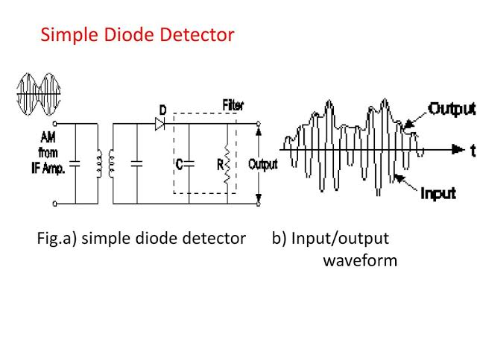
Simple Diode Detector
1. We try to detect the upper envelop from the modulated wave.
2. Output of the diode is upper envelop.

Slide 3
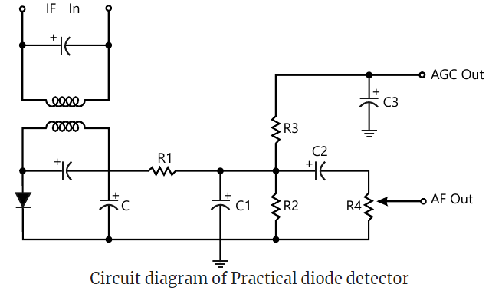
Practical Diode Detector
1. Input is negative envelop from the modulated wave.
2. Output is Negative Dc AGC output.

Slide 4
Automatic Gain Control (AGC)
1. Automatic gain control (AGC) is a mechanism wherein the overall gain of the radio reciever is automatically varied according to the changing strength of the received signal.
2. This is done to maintain the output at a constant level.
3. Weaker signal receive more gain and stronger signal receive less gain.
4. AGC is applied to the RF , AF and Mixer stages.

Slide 5
Thank You !

